Slide 1
A fuzzy rule-based industry 4.0 maturity model for operations and supply chain management
Dr. Sharifi
Hirad Pejman
Alireza Najafi

Slide 2
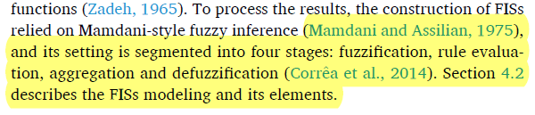
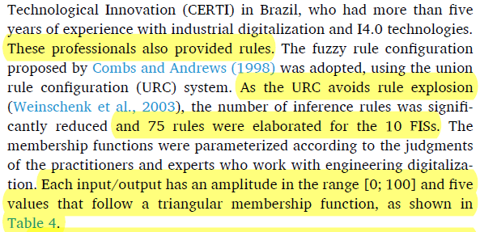
نکات مهم طراحی

Slide 3
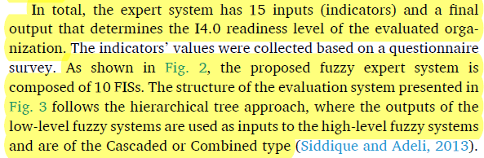
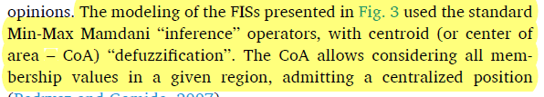
نکات مهم طراحی

Slide 4
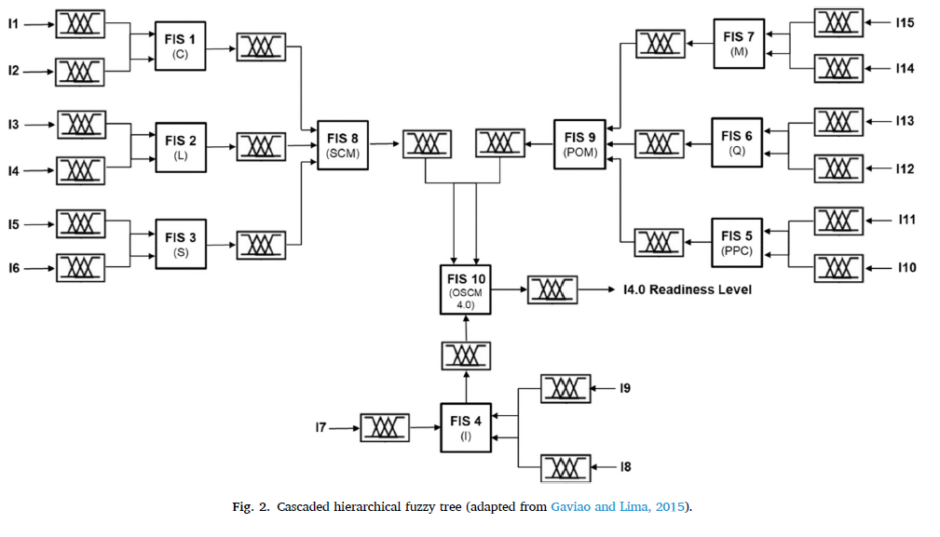
نکات مهم طراحی

Slide 5
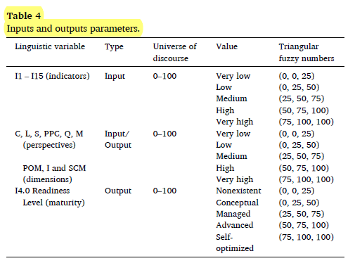
نکات مهم طراحی

Slide 6
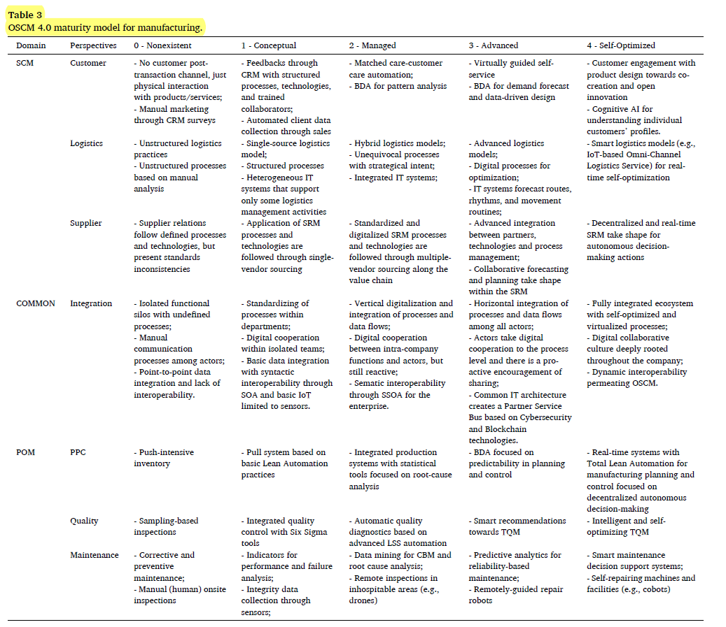
نکات مهم طراحی

Slide 7
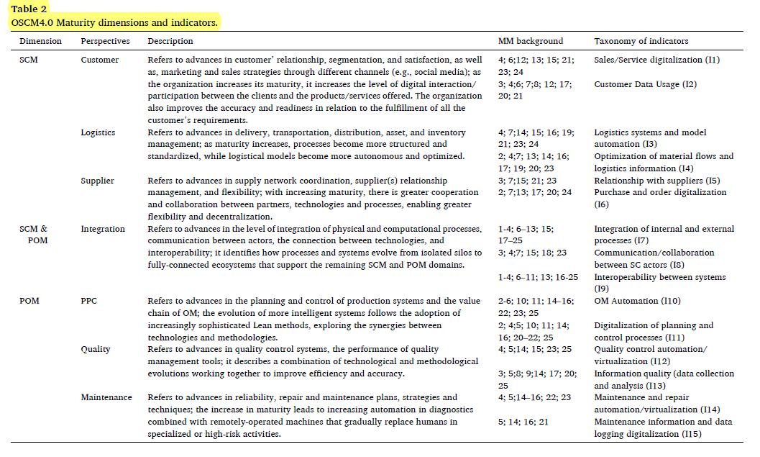
نکات مهم طراحی
Supply chain management (SCM) is the centralized management of the flow of goods and services and includes all processes that transform raw materials into final products. By managing the supply chain, companies can cut excess costs and deliver products to the consumer faster.
Page Object Model (POM) is a design pattern in Selenium that creates an object repository for storing all web elements. It is useful in reducing code duplication and improves test case maintenance. Using these elements, testers can perform operations on the website under test

Slide 8
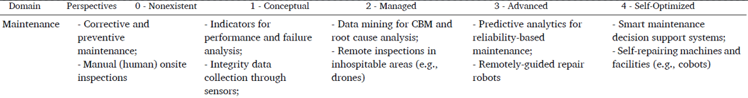
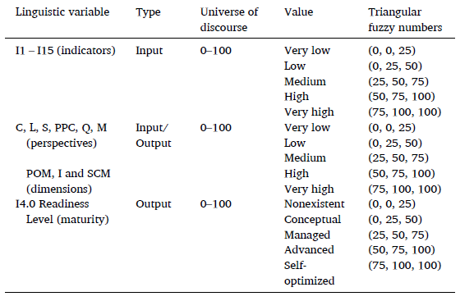
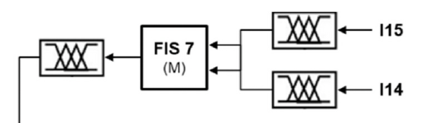
نوشتن قانون برای POM - Maintenance
داده ها

Slide 9
لیبل گذاری موارد مربوط به وردی های I14 و I15
I15
I15
I14
I14
I14
I14
I15
I15
I15
I14

Slide 10
لیبل گذاری موارد مربوط به وردی های I14 و I15
I14
I15
I15
I15
I15
I14
I15
I14
I14
I14
Self-repairing machines and facilities
Corrective and preventive maintenance
Remote Inspection in inhospitable areas
Manual onsite inspection
Remotely guided repair robots
I14
Indicators for performance and failure analysis
Smart maintenance decision support systems
Data mining for CBM and root cause analysis
Integrity data collection through sensors
Predictive analysis for reliability-based maintenance
I15
0 : very Low
1: Low
2 : Medium
3 : High
4 : Very High

Slide 11
لیبل گذاری موارد مربوط به وردی های I14 و I15
I14
I15
I15
I15
I15
I14
I15
I14
I14
I14
Self-repairing machines and facilities
Corrective and preventive maintenance
Remote Inspection in inhospitable areas
Manual onsite inspection
Remotely guided repair robots
I14
Indicators for performance and failure analysis
Smart maintenance decision support systems
Data mining for CBM and root cause analysis
Integrity data collection through sensors
Predictive analysis for reliability-based maintenance
I15
0 : very Low
1: Low
2 : Medium
3 : High
4 : Very High

Slide 12
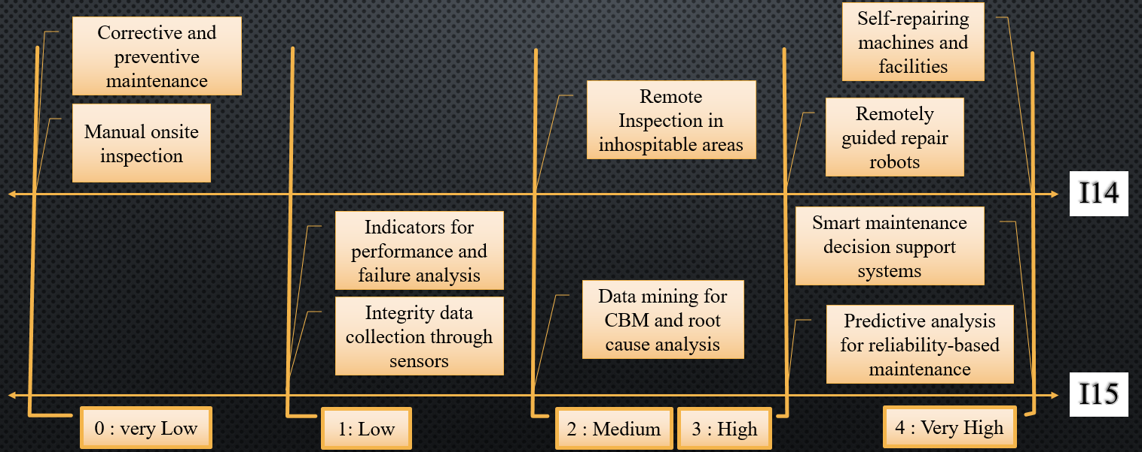
قانون های بخش Maintenance
Advantage
IF I14 is very low and I15 is very low THEN M is very low
IF I14 is very low and I15 is low THEN M is low
IF I14 is very low and I15 is Medium THEN M is low
IF I14 is very low and I15 is very low THEN M is very low
IF I14 is low and I15 is very low THEN M is very low
IF I14 is Medium and I15 is very low THEN M is low
IF I14 is Medium and I15 is very low THEN M is low
آیتم های I15 و I14 را هم وزن و هم ارزش گرفته شده اند.

Slide 13
قانون های بخش Maintenance
No - Advantage
IF I14 is Medium and I15 is High THEN M is Medium
IF I14 is low and I15 is Very High THEN M is Medium (Not sensible)
آیتم های I15 و I14 را هم وزن و هم ارزش گرفته شده اند.

Slide 14
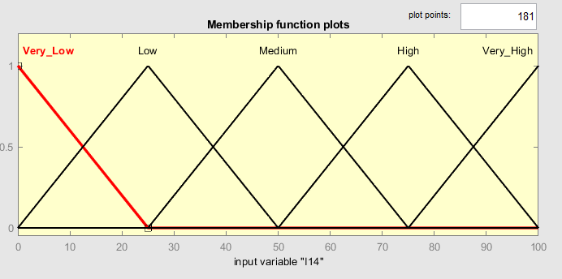
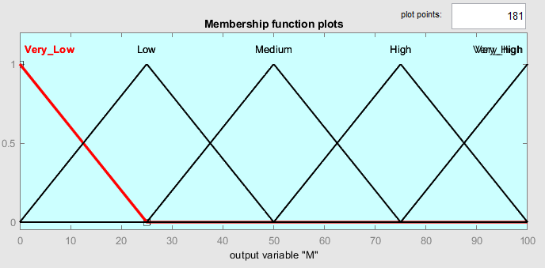
پیاده سازی اولیه در Matlab
I14 and I15 Membership functions
Output Membership functions

Slide 15
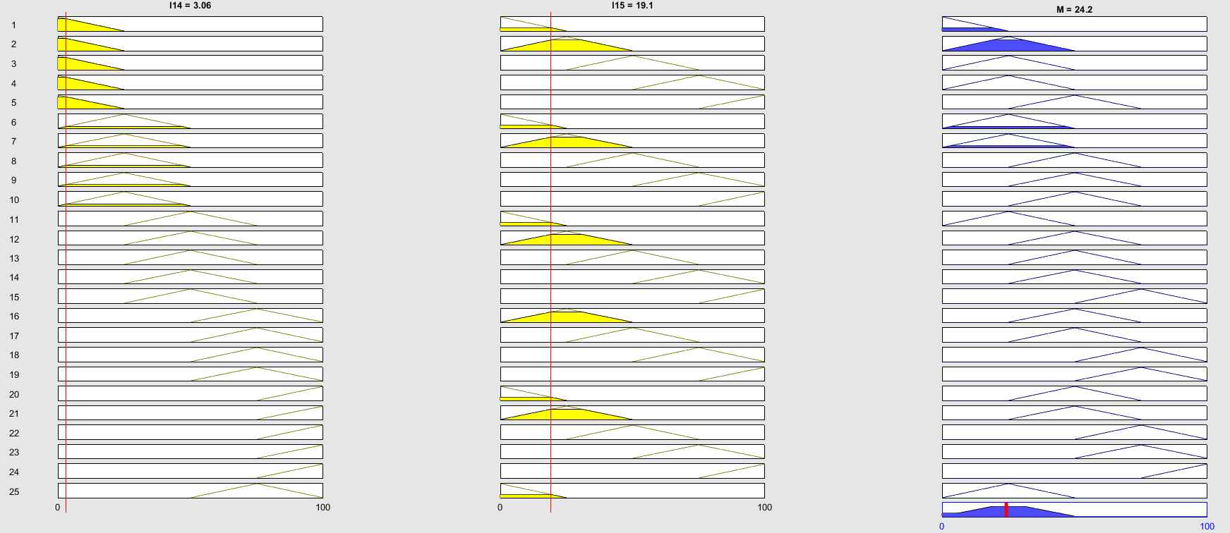
پیاده سازی اولیه در Matlab
نمونه ی یک مورد که شامل Advantage میشود IF I14 is very low and I15 is low THEN M is low

Slide 16
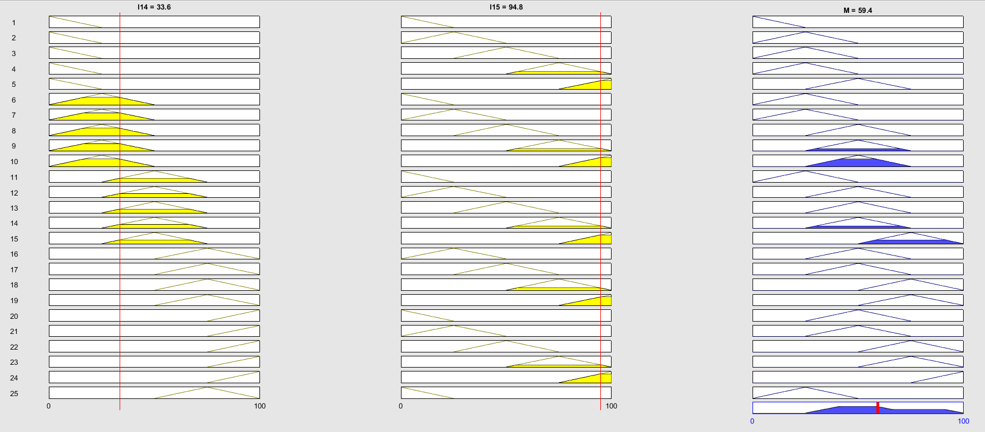
پیاده سازی اولیه در Matlab
نمونه ی یک مورد که شامل Advantage نمیشود IF I14 is low and I15 is Very High THEN M is Medium

